Slide 1
CyberSecurity Risk Management
Presented by:- Kundan Gawande(28806)

Slide 2

CYBER ATTACKS

Slide 3
What is Cyber Security ??
It are the Measures taken to protect a computer or a computer system( as on a network) against unauthorized access or attacks.

Slide 4
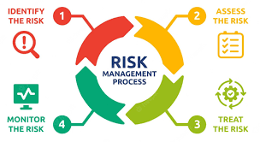
Risk Management

Slide 5
Key Points: Identify Risks First, find out what could go wrong—like someone stealing data or a virus damaging your system. Assess the Impact Understand how bad it would be if the risk actually happened. Would it cause small problems or big losses? Reduce the Risk Take steps to protect your systems—like using strong passwords, installing antivirus software, and updating software regularly. Monitor Regularly Keep checking for new threats and make sure your protection methods are still working. Have a Plan Be ready with a plan to fix things quickly if something bad does happen—like a backup or emergency response.

Slide 6

Common Cyber security Risks
Malware(viruses)
Phishing Attacks
Insider Threats
Weak Passwords

Slide 7
Best Practices & Conclusion
Implement strong passwords
Regular security training for employees
Keep systems updated
Use antivirus & firewalls
Backup data regularly
Conclusion: Effective risk management protects business continuity and data security.

